Slide 1

HCI - Assignment n.2
Design and prototyping of an application using a human-centered approach
Final presentation and demo
Project Title: ScoutPanel
Group: Daniel Silva, Marco Almeida, Adalberto Vaz do Rosário
Lab Class: P5
HCI 2022-2023
Notes:
DANIEL

Slide 2
Introduction
ScoutPanel
ScoutPanel is a platform that allows scouts (or their parents) to perform actions and consult information related to their scout unit
We chose this project because one of the members of the group is a scout and knows the movement very well.
We have personal interest in this project because as our colleague would like to implement this project in the real world, we as a group would like to take the opportunity to, in addition to doing the project from an academic point of view, also live the work experience in the real world.
HCI 2022-2023
‹#›
Notes:
being from São Tomé and knowing the need to have a system to facilitate and help in the management of this group, which, according to him, is a large group and currently the only means of management is paper and ballpoint pen. He proposed the theme and we found it interesting to use in the discipline.

Slide 3

Project Objectives
ScoutPanel
High-level goals:
Share photos with other scouts/parents;
Pay fees through online platforms;
Check members’ payments as admin;
Manage enrolled scouts.
Expected outcomes:
Having a platform with a simple (and easy to navigate) user interface and the aforementioned features.
Benefits:
Communication between members without needing an external platform (e.g. Facebook, Whatsapp);
Less reliance on paper records for management;
Common news feed available to all members.
HCI 2022-2023
‹#›
Notes:
DANIEL
OBJETIVOS: partilhar fotos com outros membros, fazer pagamentos, verificar pagamentos como admin, gerir inscritos
RESULTADOS ESPERADOS: ter uma plataforma simples de usar com as funcionalidades descritas
BENEFICIOS: comunicação entre membros sem plataforma externa, menos papel, feed comum

Slide 4

Personas
Maria Alves
19 years old
Student
Is enrolled in the Movimento de Escuteiros de Trindade, group nº 2
Would like to share photos that she took during activities with the other scouts and parents
Gabriel Nogueira
30 years old
Professor
Leader of scout group nº 2
Would like to manage the list of enrolled scouts and verify their payments without needing to check paper records
HCI 2022-2023
‹#›
Notes:
DANIEL
Maria Alves, 19 anos, estudante, inscrita no movimento de escuteiros de trindade grupo 2. quer partilhar fotos que tirou durante atividades com outros escuteiros e pais
Gabriel Nogueira: 30 anos, professor, lider do grupo no 2, quer gerir a lista de inscritos e verificar os pagamentos sem precisar de usar registos em papel

Slide 5
Scenarios
Scenario 1:
Maria took a lot of photos during the last scout activity and now wants to share them.
To do this, she will open the ScoutPanel platform and post the photo album in a feed that is shared between all members.
Her colleagues will be able to check the post.
Scenario 2:
Gabriel wants to enroll a new member to the scout group nº 2.
To do this, he will open the ScoutPanel platform and go to the “new member” page.
He will fill all the information about the new member and submit the registration form.
The new member will be added to the members list.
HCI 2022-2023
‹#›
Notes:
DANIEL
maria tirou muitas fotos durante a ultima atividade e agora quer partilhá-las
para isso, abre o socutpanel e publica o album de fotos no feed partilhado
os colegas dela vão poder ver a publicação
gabriel quer inscrever um novo escuteiro no grupo 2
para isso abre o scoutpanel e vai á pagina de novo membro no painel de adming. preenche

Slide 6
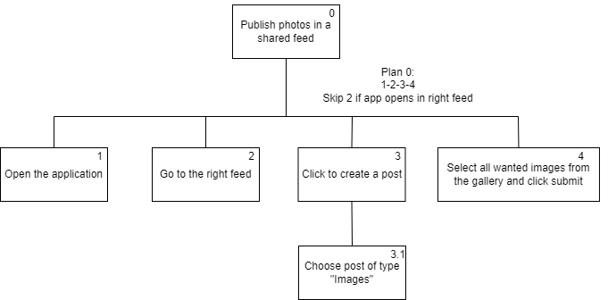
Tasks
HCI 2022-2023
‹#›

Slide 7
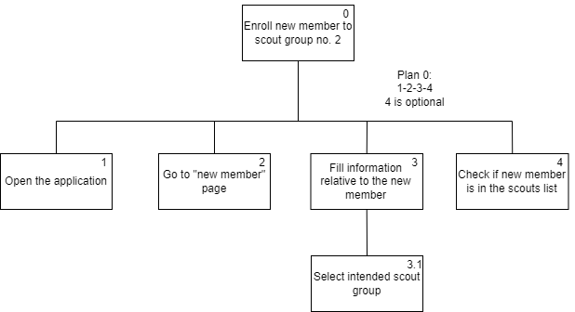
Tasks
HCI 2022-2023
‹#›

Slide 8
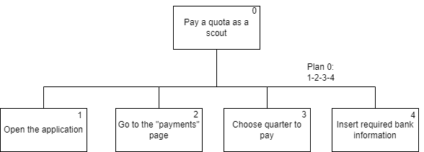
Tasks
HCI 2022-2023
‹#›

Slide 9
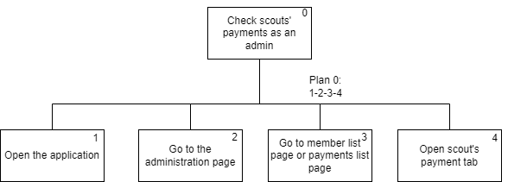
Tasks
HCI 2022-2023
‹#›

Slide 10

Requirements
Non-functional requirements – The system must have fast feedback; It must be intuitive to use, have 100% availability and guarantee the security and privacy of users.
Functional Requirements - Pay fees in the platform; Consultation of the scouts' personal data/payments; Share and publish photos of activities; Enroll new members in a scout group.
HCI 2022-2023
‹#›
Notes:
Non-functional: The monthly fee invoice must be provided every first Sunday of the month; The payment receipt must be sent no later than 48 hours after payment, on working days.

Slide 11
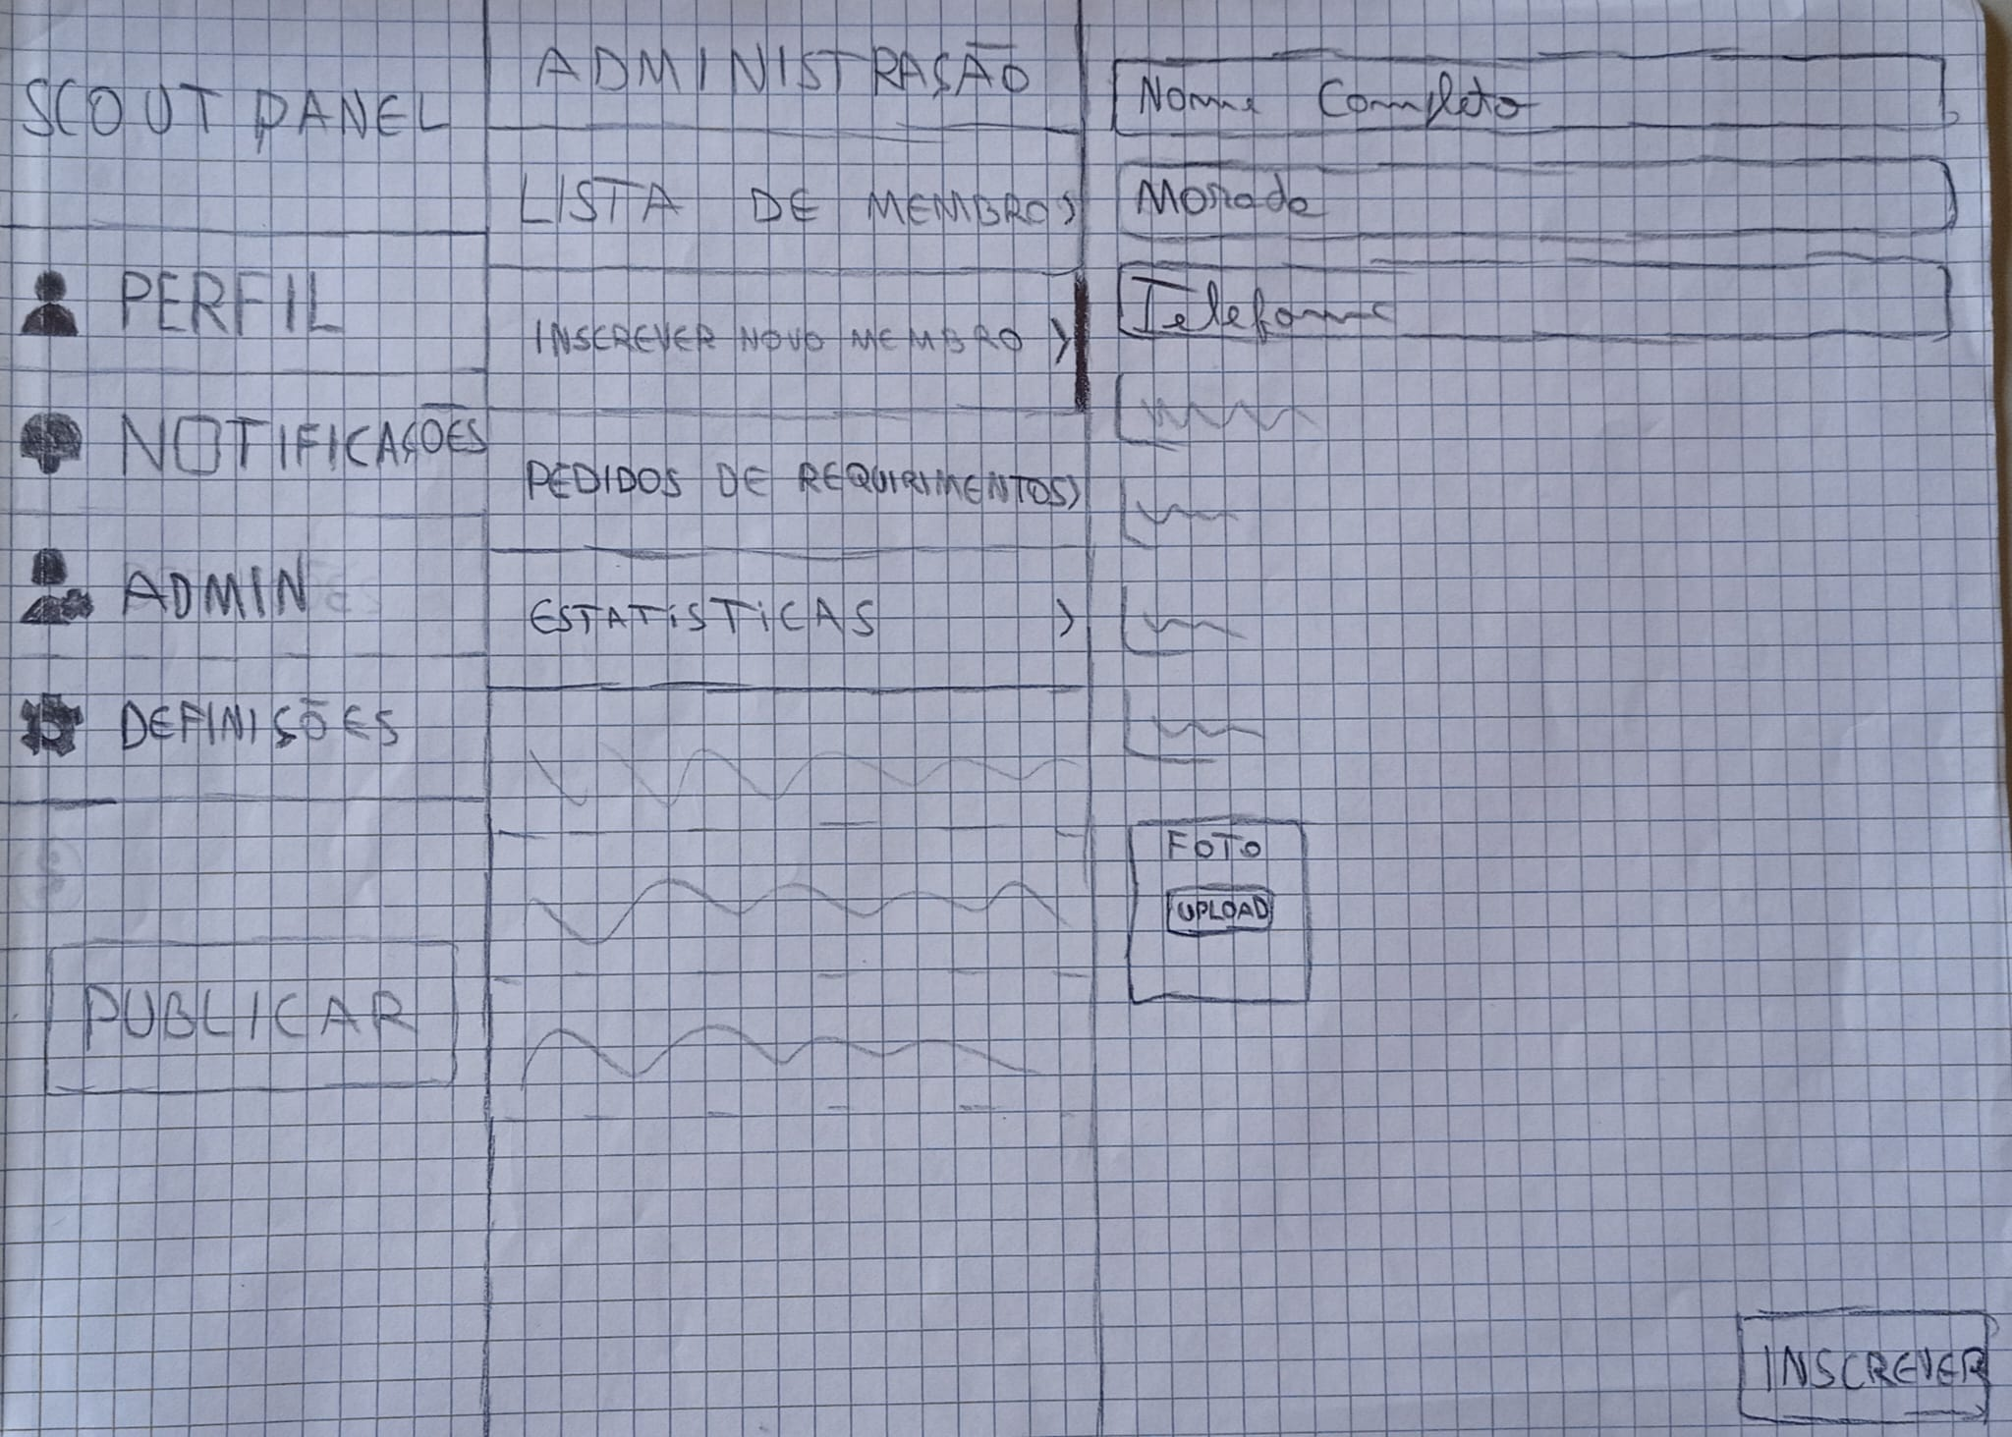
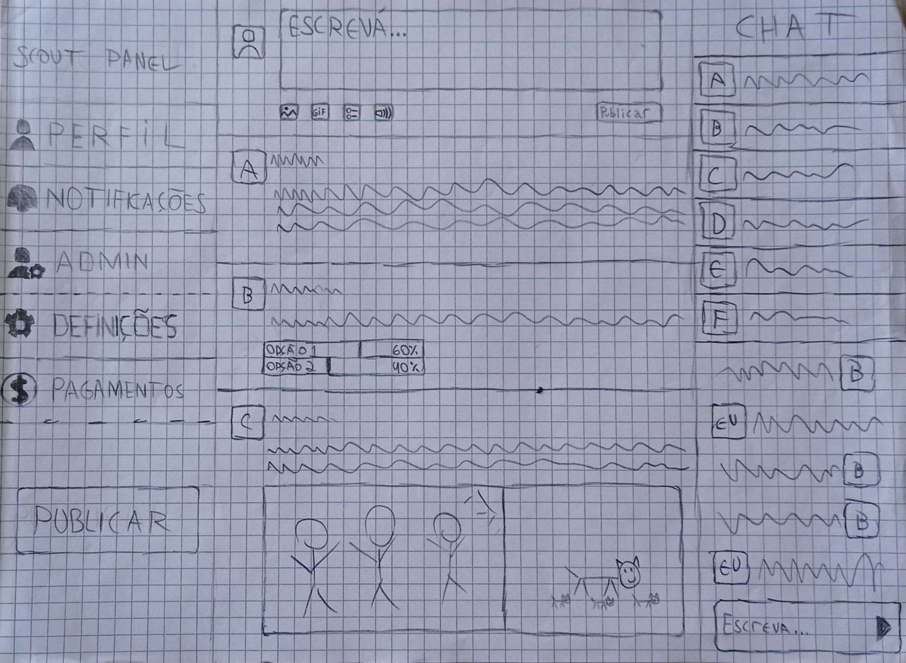
Low Fidelity Prototype (LFP)
ScoutPanel
We used a paper prototype to demonstrate how a user would perform some of the main tasks.
HCI 2022-2023
‹#›
Notes:
This is new material; should be presented in more detail

Slide 12

LFP User Evaluation
ScoutPanel
We wanted to evaluate: Usability, ease of use.
Personas: Maria Alves and Gabriel Nogueira
Scenarios: Scenario 1 and Scenario 2
We used 3 tasks, of which: Publish Photo, (Admin) Enroll new member, pay quotas;
11 participants evaluated our prototype, all were students.
Main results:
Publish button is hard to find;
Add a X in the enroll new member pop up.
In general, easy and straightforward usage.
HCI 2022-2023
‹#›

Slide 13


Platform Used for the functional prototype
ScoutPanel
Platform built with HTML, CSS and JavaScript, to be accessed on a browser.
To build the interface we used Svelte, that makes it very easy to introduce reactivity into a web app.
We also used Bootstrap, to help us improve the design of the interface.
Visual Studio Code used as IDE, and GitHub as version control platform.
HCI 2022-2023
‹#›
Notes:
DANIEL

Slide 14
User Evaluation of the functional prototype
ScoutPanel
Task 1 → Publish photos in a shared feed(Scout).
Task 2 → Enroll new member to scout group no 2.
Task 3 → Show How many months Ana Laura Barros scout has in debt.
Task 4 → Pay a month's debt(Scout dues).
8 participants(1 -> F, 7-> M):
7 Students
1 Teacher
HCI 2022-2023
‹#›

Slide 15
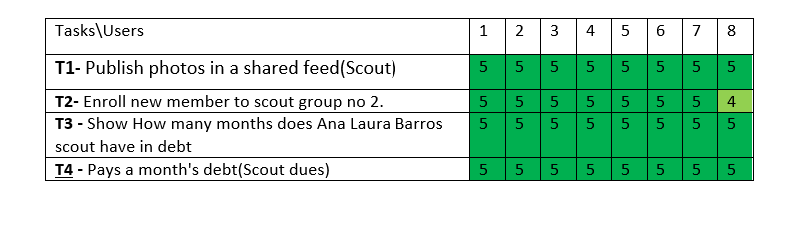
User Evaluation of the functional prototype
ScoutPanel
All users completed all tasks successfully.
HCI 2022-2023
‹#›

Slide 16
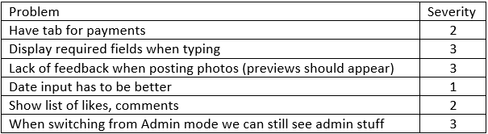
Heuristic Evaluation
ScoutPanel
After an evaluation of the functional prototype, the comments of the users were saved and a heuristic evaluation was performed with it to determine the degree of severity of the problems.
Issues 1, 2 and 5 were solved in the final version of the prototype
HCI 2022-2023
‹#›
Notes:
DANIEL
ter secção para pagamentos
mostrar quais entradas são obrigatórias nos formulários
mostrar preview das fotos ao publicar
entrada de data tem de ser melhor
mostrar lista de likes e comentários
esconder as opções de admin ao sair do modo de admin

Slide 17
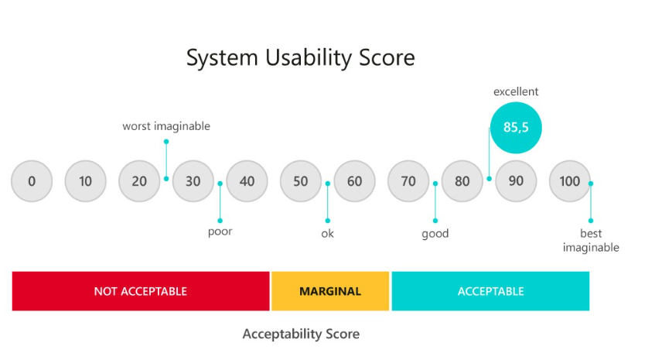
System Usability Scale
ScoutPanel
((16 + 27 + 27 + 28 + 21 + 22 + 22 + 24 + 27 + 28) * 2,5) / 7 = 86,4
According to the result we can conclude that our system has few usability problems.
HCI 2022-2023
‹#›

Slide 18

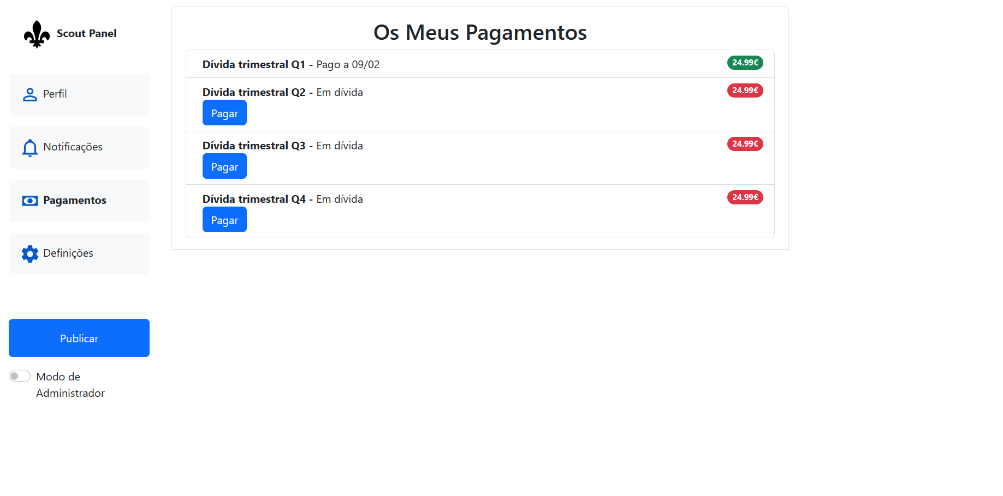
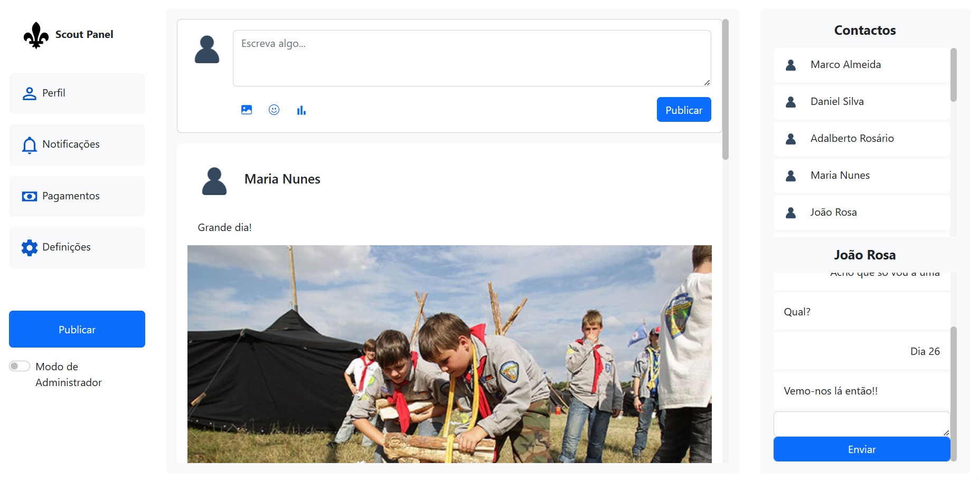
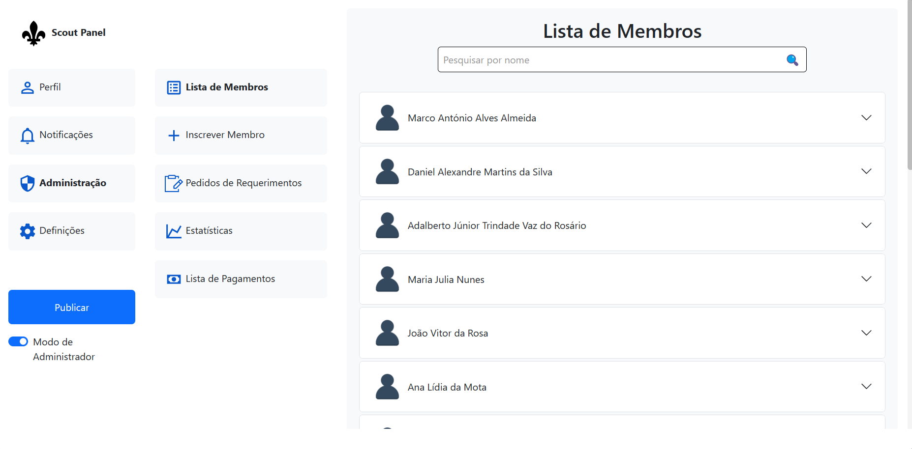
Demo
ScoutPanel
HCI 2022-2023
‹#›

Slide 19

Future work
The app should be more reactive and usable on a phone.
More pages and sections such as profile page, notifications page, and settings page should be developed.
Database integration.
Effort of each group member
Adalberto Jr.: ⅓
Daniel Silva: ⅓
Marco Almeida: ⅓
HCI 2022-2023
‹#›

Slide 20
Thank you!
HCI 2022-2023
‹#›

